Slide 1


Studies on transgenerational epigenetic inheritance of dietary factor-induced metabolic perturbation in Drosophila
Manoj Teltumbade
Supervisor: Dr. Abhay Sharma
DAC-III
8th May, 2018
Notes:
Epigenetic changes are heritable changes in gene expression, physiology or behaviour that do not involve mutations in the DNA sequence.

Slide 2
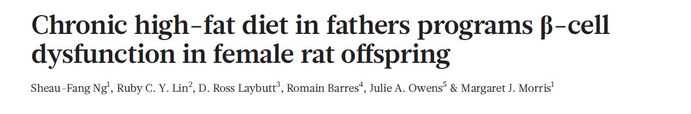
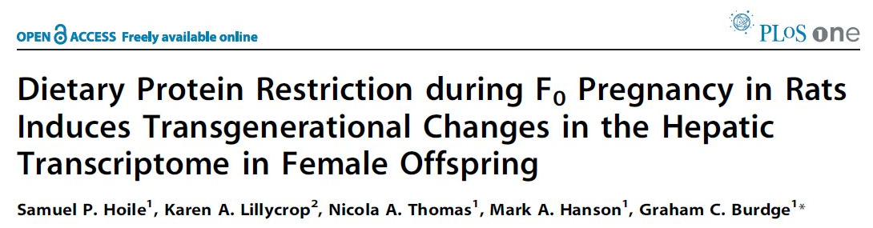
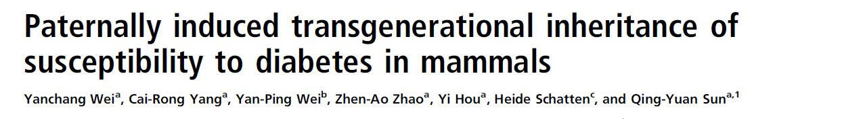
Recent studies in epigenetic inheritance
Nature. 2010 Oct
PLoS One. 2011
Proc Natl Acad Sci U S A. 2014
Notes:
There are lots of examples of recent studies published in eminent journals showing epigentic inheritance.
Father to daughters, Mother to daughters, F0 male mice to F2 progeny, 3. glucose intolerance and insulin resistance Insulin resistance was induced in male mice by feeding a high-fat diet, and impaired fasting glucose was induced by injecting these mice with a low dose of STZ,

Slide 3
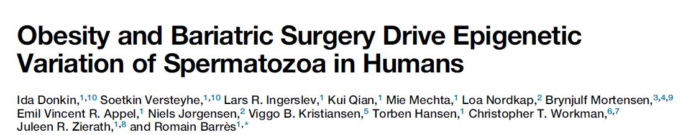
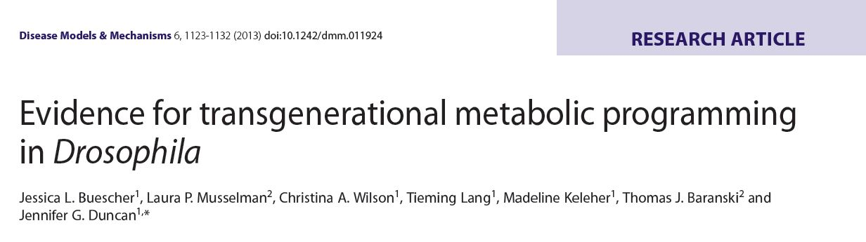
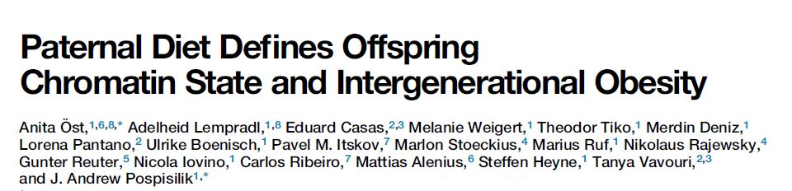
Recent studies in epigenetic inheritance
Cell Metabolism, February 9, 2016
Dis Model Mech. 2013 Sep;6(5):1123-32
Cell. 2014 Dec 4;159(6):1352-64
Notes:
1. Donkin et al. show that spermatozoa from obese men carry a distinct epigenetic signature compared to lean men, in particular at genes controlling brain development and function. The sperm methylome is dynamically remodeled after gastric-bypass-induced weight loss, notably at gene regions implicated in the central control of appetite.
2. F0 female to F2 progeny, triacylglyerides and gene expression 3. F0 males to F1 progeny, triacylglyerides and gene expression

Slide 4
Different modes of epigenetic inheritance
Soma
Environmental
factor
A
Germline
Epigenetic mark
B
C
F0
F1
F2
Notes:
There are different modes through which epigenetic information can be passed through generations. In case of A, the environmental factors changes the epigenetic marks in the germline of exposed progeny and when such marks escape through the epigenetic reprogramming then it transfers to the next generation and it may be passed to the next generation or reset during reprogramming. In case of B, environmental factor affects the somatic cells which the sends signals to the germline and such epigenetic marks are retained in subsequent generation. Third case of epigenetic inheritance can be seen in behavioral biology. In which traits like maternal care, cultural activities are continue to pass from generation to generations. Our lab is more interested in studying second mode of inheritance.

Slide 5


General schematic to test epigenetic inheritance
A: Male line
B: Female line
F0
Exposed
Normal
Exposed
Normal
F1
F2
F3

Slide 6
Proposed mechanism of Transgenerational Epigenetic Inheritance
Environmental
exposure
Evolutionary
time course
Soma
Circulation
Germline
Reprogramming
Epigenetic modification (gene expression/network, DNA methylation, histone modifications, noncoding RNA)
miRNA
Genetic
mutation
Gamete
Zygote
Post-implantation
embryo
Late fetus
Notes:
In the field of TEI, various scientists recently proposed the mechanism about how the epigenetic information can pass along from one generation to other generation. One of the proposed mechanism is environmental exposure changes the epigenetic markers in the somatic tissue, which can send signals to the germline and makes changes thereafter and pass on to the next generation.
However, there are two major concerns with this hypothesis, the epigenetics marks to carry forward to next generation, it has to escape or get protected from epigenetic resetting during two processes. 1. during gamete formation and 2. embryo differentiation.

Slide 7
Objectives
1. Investigate dietary factor induced transgenerational epigenetic inheritance of metabolic perturbations in Drosophila through male line
2. Examine genome-wide gene expression changes in the above fly model of epigenetic inheritance
3. Transgenerational analysis of networks and pathways

Slide 8

Study Design to understand Transgenerational Epigenetic Inheritance
High-Sugar(HS) Diet
Normal Diet
How does high-sugar diet perturb metabolite levels and transcriptome profile
Does such metabolite and transcriptomic perturbations persist in next generations?
How information transfers along the subsequent generations?
F1
F2
Notes:
Randomized control studies are the only way of determining what components of diet are causal; only observational studies are possible in humans because of ethics and noncompliance . On the presitigious Cochrane reviews you will only find RCTs of exercise intervention. We don’t know which diets are associated with a higher risk versus others. Past animal studies have not been comparative.
[Existing studies focus on endogenous biological function of the homologous fly gene with little reference to human disease because they start from the fly]
Unlimited supply
75% human disease genes have related sequences in D. melanogaster (defined by matches with expectation values ≤10^{–10});
Ease of Genetic manipulation

Slide 9
Study Design to understand Transgenerational Epigenetic Inheritance
High-Sugar(HS) Diet
Normal Diet
How does high-sugar diet perturb metabolite levels and transcriptome profile
Does such metabolite and transcriptomic perturbations persist in next generations?
How information transfers along the subsequent generations?
F1
F2
Notes:
Randomized control studies are the only way of determining what components of diet are causal; only observational studies are possible in humans because of ethics and noncompliance . On the presitigious Cochrane reviews you will only find RCTs of exercise intervention. We don’t know which diets are associated with a higher risk versus others. Past animal studies have not been comparative.
[Existing studies focus on endogenous biological function of the homologous fly gene with little reference to human disease because they start from the fly]
Unlimited supply
75% human disease genes have related sequences in D. melanogaster (defined by matches with expectation values ≤10^{–10});
Ease of Genetic manipulation

Slide 10

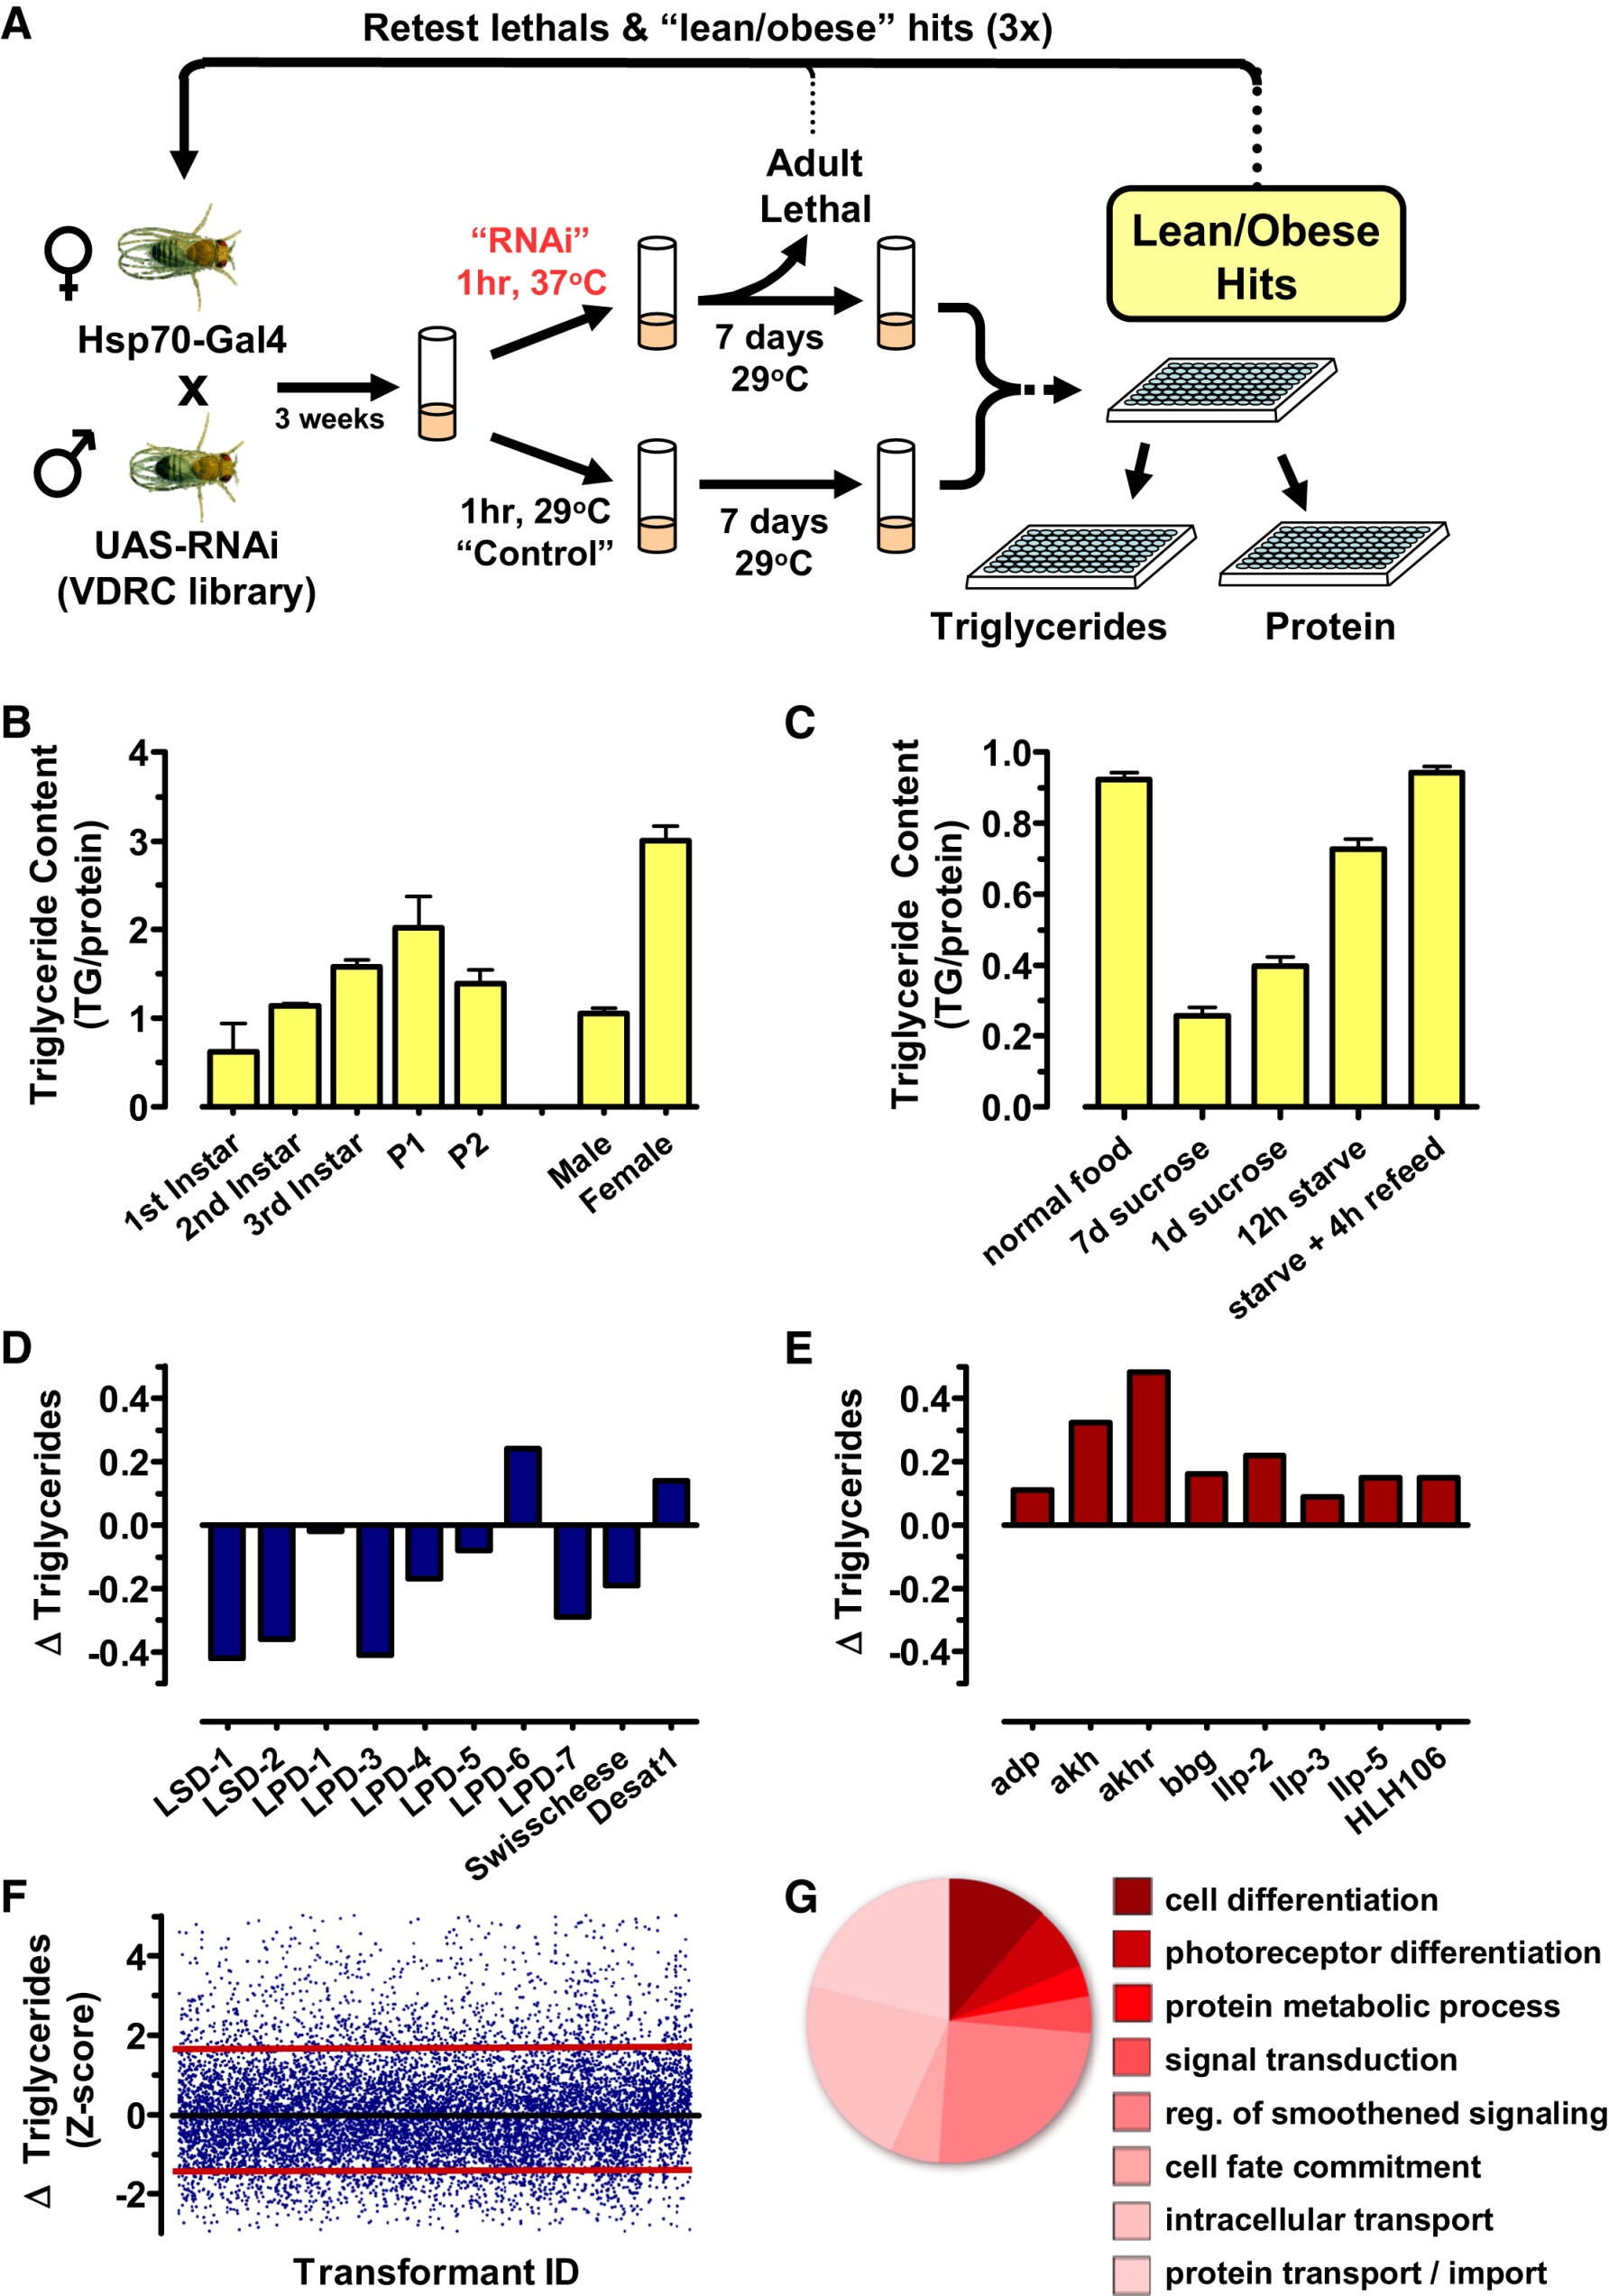
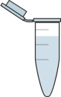
Study Design: 1a. Does high-sugar diet perturb metabolism?
2 week
Treatment
Normal Diet
High-Sugar Diet
Hemolymph
Whole Body
Hemolymph
Whole Body
Free Glucose
Triacylglycerides
Protein
Weight
Free Glucose
Triacylglycerides
Protein
Weight

Slide 11
Effect of High sugar diet on flies
Add label
Add label
Add label
Conclusion: High sugar diet affects the metabolite parameters in F0 flies

Slide 12
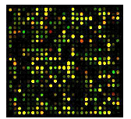
Study Design: 1b. Does high-sugar diet perturb transcriptome profile?
2 week
Treatment
Normal Diet
High-Sugar Diet
RNA isolation
RNA isolation
Transcriptome Profiling
Transcriptome Profiling

Slide 13
HSD induced whole body transcriptomic alterations in F0 adults
Male
Male
FE = 1.3
p = 2.4E-09
FE = 4.4
p < E-16
Genome
Female
Genome
Female
Number of genes
Male
Female

Slide 14
Biological process & Cellular enrichment in DN genes in F0 HSD males
-log10 p value

Slide 15
Biological process & Cellular enrichment in UP genes in F0 HSD males
-log10 p value

Slide 16
Biological process & Cellular enrichment in DN genes in F0 HSD females
-log10 p value

Slide 17
Biological process & Cellular enrichment in UP genes in F0 HSD females
Conclusion: Exposure of HSD in F0 progeny significantly affects transcriptomic profile with enrichment of energy metabolism and epigenetic processes.
-log10 p value

Slide 18
Human disease relevance in Drosophila model: Disease enrichment of genes
Disease
p value
Male
Loci influencing lipid levels and coronary heart disease risk in 16 European population cohorts
0.02
Genome-wide association analysis of metabolic traits in a birth cohort from a founder population
0.03
Common variants at 30 loci contribute to polygenic dyslipidemia
0.04
Loci influencing lipid levels and coronary heart disease risk in 16 European population cohorts
0.04
Female
Common variants at 30 loci contribute to polygenic dyslipidemia
0.02
Glycine encephalopathy
0.02
Mismatch repair cancer syndrome
0.004
Alzheimer disease, susceptibility to disease
0.02
Conclusion: Human comparison shows gene enrichment of metabolic related diseases in HSD fed flies
Six new loci associated with body mass index highlight a neuronal influence on body weight regulation
0.02
Six new loci associated with blood low-density lipoprotein cholesterol, high-density lipoprotein cholesterol or triglycerides in humans
0.06
Notes:
The four group depending on the sex of the flies and direction of regulation was compared with the human ortholog using flyrnai.org website.
When human ortholog was submitted for analysis in Online mendelian inheritance in Man, we found enrichment of the genes which has shown correlation with the disease involving various energy related metabolism

Slide 19
Summary1
High sugar diet affects the metabolite parameters in F0 flies
Exposure of HSD in F0 progeny significantly affects transcriptomic profile with enrichment of energy metabolism and epigenetic processes.
Human comparison shows gene enrichment of metabolic diseases in HSD fed flies

Slide 20
Study Design to understand Transgenerational Epigenetic Inheritance
High-Sugar(HS) Diet
Normal Diet
How does high-sugar diet perturb metabolite levels and transcriptome profile
Does such metabolite and transcriptomic perturbations persist in next generations?
How information transfers along the subsequent generations?
F1
F2
Notes:
Randomized control studies are the only way of determining what components of diet are causal; only observational studies are possible in humans because of ethics and noncompliance . On the presitigious Cochrane reviews you will only find RCTs of exercise intervention. We don’t know which diets are associated with a higher risk versus others. Past animal studies have not been comparative.
[Existing studies focus on endogenous biological function of the homologous fly gene with little reference to human disease because they start from the fly]
Unlimited supply
75% human disease genes have related sequences in D. melanogaster (defined by matches with expectation values ≤10^{–10});
Ease of Genetic manipulation

Slide 21
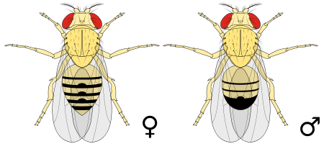
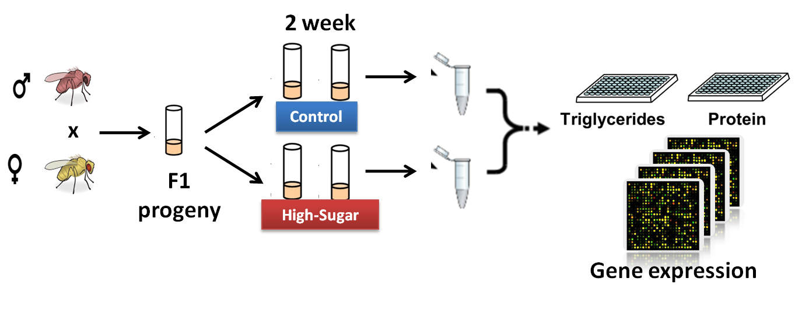
Experimental Design: F1 generation
Treatment
Control
Normal Diet
HS Diet
Normal Diet
Normal Diet
F0
Normal Diet
HS Diet
Normal Diet
HS Diet
F1
Triglycerides
Notes:
To study the effect of HSD on subsequent generation, we crossed hsd fed male with normal diet female . The eggs were layed on normal medium. After eclosion, adults were treated with 2 week of treatment and sacrifised for measurement of TAG and protein level.
For generating F2 progeny, we crossed F1 male obtained through HSD fed male line and crossed with normal female. The rest of the procedure is same.
Just to stress on the point that, no F2 generation parents didn’t have exposure to HSD only their grandparent that too male line was exposed to high sugar diet.

Slide 22
F1 generation triacylglyceride levels
Normal Diet HS Diet
Normal Diet HS Diet
Normal Diet ancestry
High sugar Diet ancestry

Slide 23
Experimental Design: F2 generation
Treatment
Control
Normal Diet
HS Diet
Normal Diet
Normal Diet
F0
Normal Diet
HS Diet
Normal Diet
HS Diet
F1
Normal Diet
HS Diet
Normal Diet
HS Diet
F2

Slide 24
F2 generation triacylglyceride levels
Normal Diet HS Diet
Normal Diet HS Diet
Normal Diet ancestry
High sugar Diet ancestry

Slide 25
Transcriptomic profile of F1 & F2 generation
Treatment
Control
Normal Diet
HS Diet
Normal Diet
Normal Diet
F0
Normal Diet
HS Diet
Normal Diet
HS Diet
F1
Normal Diet
HS Diet
Normal Diet
HS Diet
F2

Slide 26
All the results and analysis from transcriptomic profiling of F1 and F2

Slide 27
All the results and analysis from transcriptomic profiling of F1 and F2
Rotation gene set test for microarray analysis
GO enrichment
Group | Down | Up
F0_Female | 226 | 663
F0_Male | 168 | 323
F1_Female_HS | 53 | 171
F1_Female_LS | 92 | 113
F1_Male_HS | 189 | 46
F1_Male_LS | 46 | 119
F2_Female_HS | 372 | 40
F2_Female_LS | 381 | 12
F2_Male_HS | 19 | 138
F2_Male_LS | 14 | 254
Filters:
Min. number of genes in GO: 10
P-value cut-off: 0.05
https://doi.org/10.1093/bioinformatics/btq401
Notes:
Motivation: A gene set test is a differential expression analysis in which a P-value is assigned to a set of genes as a unit. Gene set tests are valuable for increasing statistical power, organizing and interpreting results and for relating expression patterns across different experiments. Existing methods are based on permutation. Methods that rely on permutation of probes unrealistically assume independence of genes, while those that rely on permutation of sample are suitable only for two-group comparisons with a good number of replicates in each group.
A gene set test is a differential expression analysis in which a set of putatively co-regulated genes is treated as a unit. A single P-value is evaluated for the set rather than evaluating individual P-values for individual genes.
Gene set tests can be statistically more powerful than genewise tests as evidence is accumulated from many genes.

Slide 28
GO overlaps between F0 and F1 males

Slide 29
Biological Process Enrichment: F0-F1 male comparison
F0 male
Downregulated
F1 male
Upregulated
Notes:
LS diet

Slide 30
Biological Process Enrichment: F0-F1 male comparison
F1 male
Downregulated
F0 male
Upregulated
Notes:
LS diet

Slide 31
GO overlaps between F0 and F1 females

Slide 32
Biological Process Enrichment: F0-F1 female comparison
F0 female
Downregulated
F1 female
Upregulated

Slide 33
Biological Process Enrichment: F0-F1 female comparison
F1 female
Downregulated
F0 female
Upregulated
Notes:
subset

Slide 34
GO overlaps between F0 - F2 males and F0 – F2 females
p = 1.29E-12

Slide 35
Biological Process Enrichment: F0-F2 male comparison
F0 male
Downregulated
F2 male
Upregulated

Slide 36
Summary2

Slide 37
Study Design to understand Transgenerational Epigenetic Inheritance
High-Sugar(HS) Diet
Normal Diet
How does high-sugar diet perturb metabolite levels and transcriptome profile
Does such metabolite and transcriptomic perturbations persist in next generations?
How information transfers along the subsequent generations?
F1
F2
Notes:
Randomized control studies are the only way of determining what components of diet are causal; only observational studies are possible in humans because of ethics and noncompliance . On the presitigious Cochrane reviews you will only find RCTs of exercise intervention. We don’t know which diets are associated with a higher risk versus others. Past animal studies have not been comparative.
[Existing studies focus on endogenous biological function of the homologous fly gene with little reference to human disease because they start from the fly]
Unlimited supply
75% human disease genes have related sequences in D. melanogaster (defined by matches with expectation values ≤10^{–10});
Ease of Genetic manipulation

Slide 38
Future Plan
Transcriptomic analysis of
Sperm of F0 HSD males
F1 embryo obtained from: HSD male X normal female
Meta-analysis of F0 to F2 pathway and network data

Slide 39
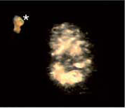
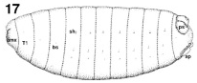
Schematic of fly -> sperm -> embryo -> F1 generation
HS Diet fed Father
Control Diet fed Father
Sperm
HS Diet
Normal Diet
Normal Diet
Normal Diet
F0 Adult
Stage 17 embryo
Normal Diet
HS Diet
Normal Diet
HS Diet
F1 Adult
Image not to scale
Atlas of Drosophila Development by Volker Hartenstein
Notes:
doi:10.1038/ng1915

Slide 40
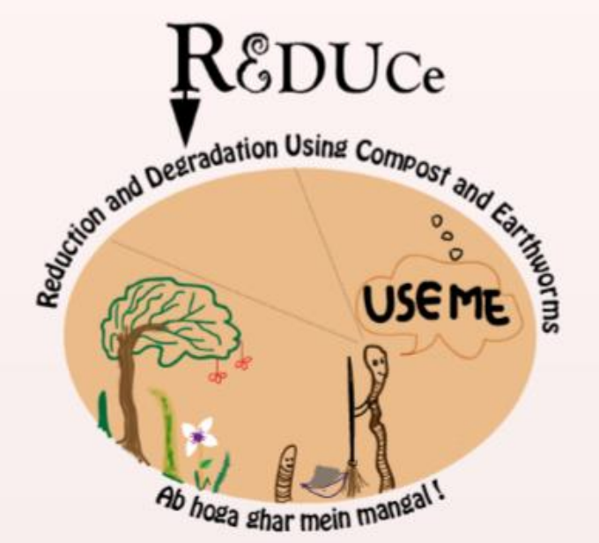
CSIR 800 Project - REDUCE
(Reduction and Degradation Using Compost and Earthworms)
The broad aim of this project was to assess the feasibility of replacing the conventional mixed dustbin in urban and semi-rural houses with a vermicompost bin to reduce the use of plastic bags for waste disposal.
Designed the questionnaires for survey, built the survey forms as smart forms , used these survey forms by ODK Collect mobile app and made the database for survey by ODK Aggregate.
Made the website for the project http://www.igib.res.in/csir800/

Slide 41

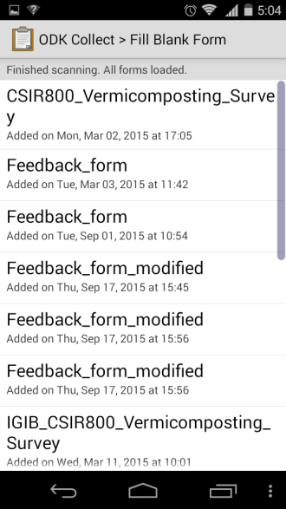








Smart forms for ODK collect

Slide 42








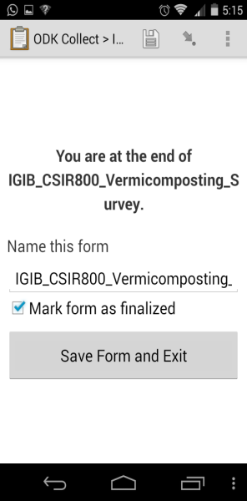

Smart forms for ODK collect

Slide 43
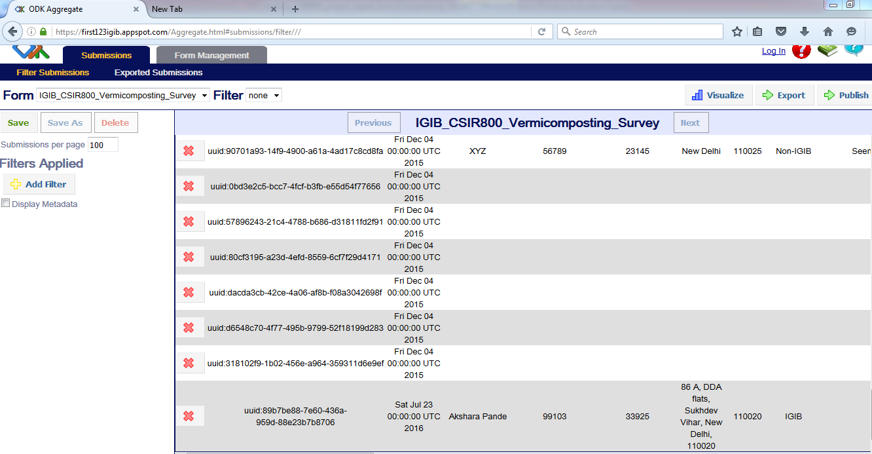

Slide 44
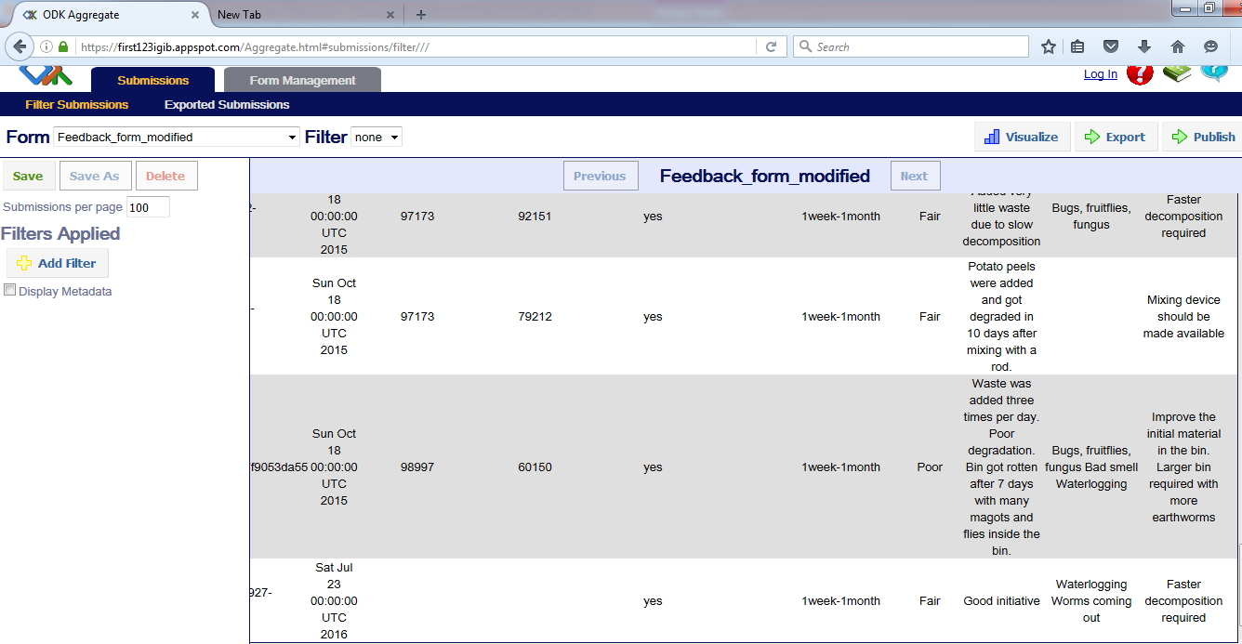

Slide 45



Acknowledgements
PhD supervisor:
Dr. Abhay Sharma
DAC Committee:
Dr. Dwaipayan Bharadwaj
Dr. Shantanu Sengupta
Dr. Sridhar Sivasubbu
Director:
Dr. Anurag Agrawal
Lab Members:
Mr. Ameek Bhalla
Mr. Karunakar Pinreddy

Slide 46

Notes:
Doubt the conventional wisdom unless you can verify it with reason and experiment.

Slide 47
Lifespan assays

Slide 48
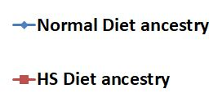
Lifespan assays: F1 generation

Slide 49
Lifespan assays: F2 generation

Slide 50
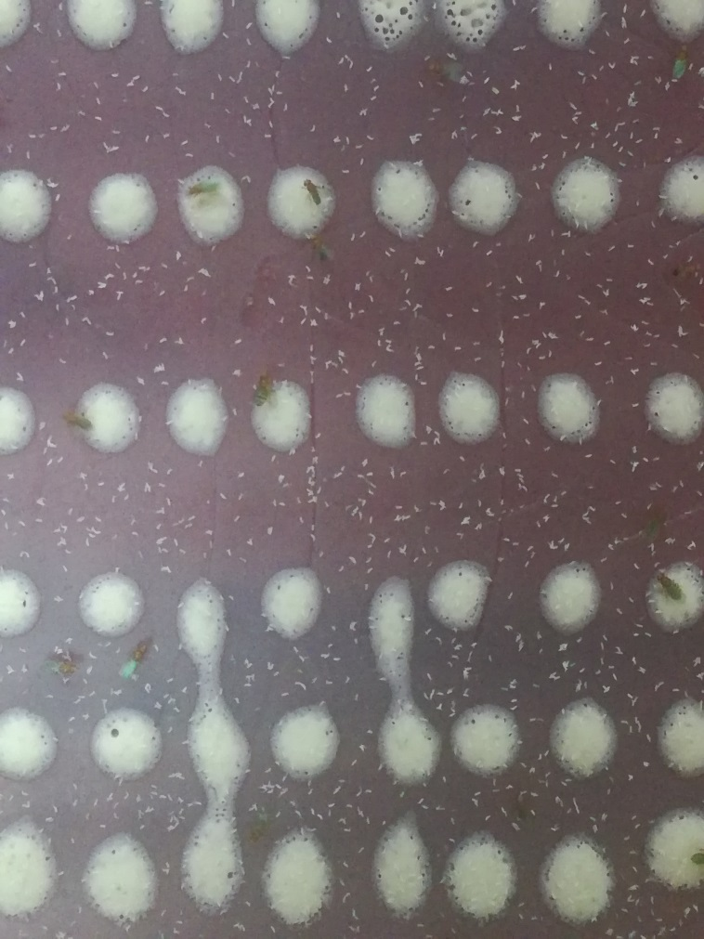
24 hour Embryo Collection from
2000 males X 2000 females

